Slide 1

SURVIVAL ANALYSIS
COLORECTAL CANCER

Slide 2






MEET THE TEAM
Shashank Shekhar
C20024
Mohit Kumar Saini
C20015
Debajyoti Podder
C20011
Sourav Maji
C20026
Amit Agarwal
C20003
Agastya Bhooshan
C20002

Slide 3
BRIEF INTRODUCTION
WHAT IS CANCER?
WHAT IS TUMOR?
WHAT IS COLON CANCER?
• Cancer is the second leading cause of death globally, and is responsible for an estimated 9.6 million deaths in 2018. Globally, about 1 in 6 deaths is due to cancer.
• According to WHO Colon cancer is the third most common cancer with about 1.80 million cases worldwide. Colorectal cancer is the third most commonly occurring cancer in men and the second most commonly occurring cancer in women.
• In 2020, approximately 147,950 individuals will be diagnosed with CRC and 53,200 will die from the disease, including 17,930 cases and 3,640 deaths in individuals aged younger than 50 years according to - National Center for Health Statistics (US).
STATISTICS
(COLON CANCER)

Slide 4
OVERVIEW
PROBLEM STATEMENT
New treatments for primary and metastatic colorectal cancer have emerged, like laparoscopic surgery for primary disease and adjuvant chemotherapies. This study provides an overview of the impact of these new treatment on cure rates and long-term survival.
STUDY DESIGN
Cohort Forward Directional Study Design
SOURCE
The North Central Cancer Treatment Group and the Mayo Clinic. J Clinical Oncology, 7:1447-1456, 1989.
METHODS
Patient Selection
Stratification and Randomization
Statistical Analysis

Slide 5
DATA UNDERSTANDING
ETYPE
STATUS
RX
SEX
AGE
OBSTRUCT
ADHERE
RECURRENCE(1)
DEATH(2)
CENSORED(0)
UNCENSORED(1)
OBS
LEV
LEV+5FU
MALE (1)
FEMALE(0)
RANGE (16-86)
YES (1)
NO (0)
YES (1)
NO(0)
PERFOR
NODES
NODE4
EXTENT
DIFFER
SURG
TIME
YES(1)
NO (0)
RANGE(0-33)
NODES< =4 (0)
NODES > 4 (1)
Submucosa(1)
Muscle(2)
Serosa(3)
Contiguous Structures(4)
Well (1)
Moderate (2)
Poor (3)
Short (0)
Long (1)
No of days

Slide 6
DATA DESCRIPTION
PERCENTAGE DISTRIBUTION OF INDEPENDENT VARIABLES w.r.t TREATMENT
AGE : ETYPE : MEAN TIME
AGE : NODE : MEAN TIME
ETYPE: TREATMENT : MEAN TIME
ETYPE : NODE : MEAN TIME

Slide 7

KAPLAN-MEIER
KAPLAN-MEIER
& LOG RANK TEST
H0 : The K-M Curves are similar
Ha: The K-M Curves are different

Slide 8
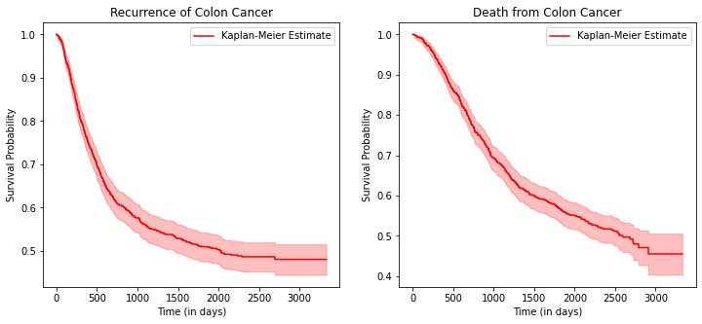
KAPLAN-MEIER
Kaplan-Meier survival plot for both the event.
Survival plot for the event death is more steep than recurrence.
Survival probability for event Death is more than the event of Recurrence.

Slide 9
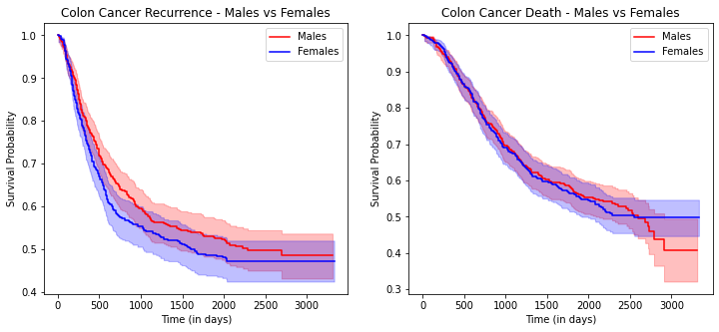
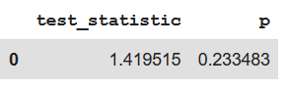
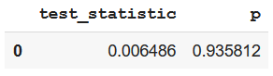
KAPLAN-MEIER
Kaplan-Meier survival plot for both the events w.r.t sex.
From the p-value we can infer that sex is not associated with survival probability.
Survival probability curve cannot be significantly differentiated for none of the event.
Log-rank test

Slide 10
KAPLAN-MEIER : Descriptive Measures of Survival Experience
VALUE | RECURRENCE |  |  | DEATH
 | TREATMENT (RX) |  |  | TREATMENT (RX)
 | OBS | LEV | LEV+5FU | OBS | LEV | LEV+5FU
No. of Total Patients (A) | 306 | 294 | 289 | 305 | 294 | 289
No. of Uncensored Patients (B) | 172 | 161 | 113 | 164 | 149 | 117
Total observed survival time in days (C) | 390095 | 391852 | 470449 | 487901 | 477776 | 521505
T̅ (Average Survival Time) = C/A | 1274.82 | 1332.83 | 1627.851 | 1599.675 | 1625.088 | 1804.516
h̅ (Average Hazard Rate) = B/C | 0.000441 | 0.000411 | 0.00024 | 0.000336 | 0.000312 | 0.000224
MAXIMUM VALUE
MINIMUM VALUE
(SURVIVAL PROBABILITY)
(AVERAGE HAZARD RATE)

Slide 11
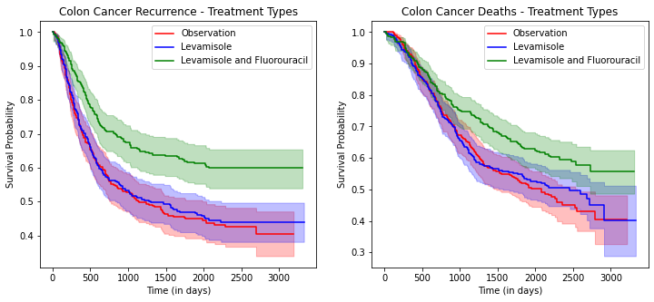
KAPLAN-MEIER
Kaplan-Meier survival plot for both the events w.r.t treatment process.
These plots indicate that group with Lev+5FU has better survival prognosis than other groups.
The p-value suggests that we can reject the Null hypothesis for plots between Obs & Lev+5FU and Lev & Lev+5FU.
test_statistic | p | Treatment Type
0.299226 | 0.584368 | Obs & Lev
test_statistic | p | Treatment Type
10.252675 | 0.001365 | Obs & Lev+5FU
test_statistic | p | Treatment Type
6.596655 | 0.010217 | Lev & Lev+5FU
test_statistic | p | Treatment Type
0.1365 | 0.711786 | Obs & Lev
test_statistic | p | Treatment Type
19.122169 | 0.000012 | Obs & Lev+5FU
test_statistic | p | Treatment Type
15.770674 | 0.000072 | Lev & Lev+5FU
Log-rank test

Slide 12
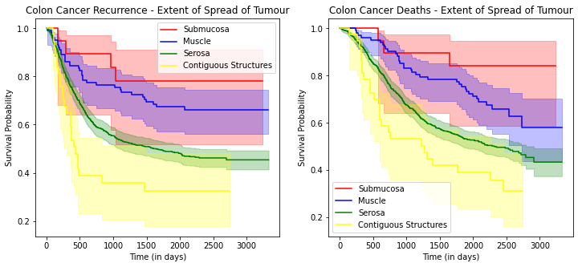
KAPLAN-MEIER

Slide 13
LOG RANK TEST
test_statistic | p | Tumor Spread
2.409521 | 0.120599 | Submucosa & Muscle
test_statistic | p | Tumor Spread
7.308426 | 0.006863 | Submucosa & Serosa
test_statistic | p | Tumor Spread
11.651118 | 0.000642 | Submucosa & Contiguous Structures
test_statistic | p | Tumor Spread
10.682074 | 0.001082 | Muscle and Serosa
test_statistic | p | Tumor Spread
16.859804 | 0.00004 | Muscle and Contiguous Structures
test_statistic | p | Tumor Spread
4.971242 | 0.025772 | Serosa and Contiguous Structures
test_statistic | p | Tumor Spread
0.998545 | 0.317663 | Submucosa & Muscle
test_statistic | p | Tumor Spread
5.975471 | 0.014506 | Submucosa & Serosa
test_statistic | p | Tumor Spread
10.203182 | 0.001402 | Submucosa & Contiguous Structures
test_statistic | p | Tumor Spread
12.662975 | 0.000373 | Muscle and Serosa
test_statistic | p | Tumor Spread
18.10915 | 0.000021 | Muscle and Contiguous Structures
test_statistic | p | Tumor Spread
5.93923 | 0.014807 | Serosa and Contiguous Structures
Log-rank test
Colon Cancer Recurrence - Extent of Tumor
Colon Cancer Deaths - Extent of Tumor
This Log-rank test compare the four groups of Tumor Spread:
We infer the following from the Chi-Square statistics
Comparing Survival Probability except Submucosa and Muscle all the other groups are significantly different.

Slide 14
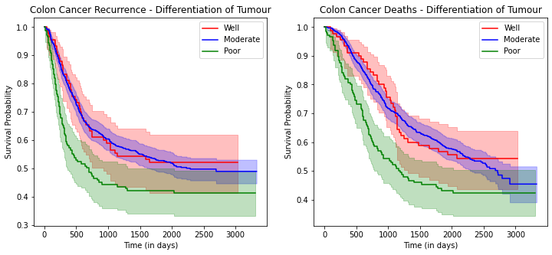
KAPLAN-MEIER
This Log-rank test compare the three different groups of Tumor
We infer the following from the Chi-Square statistics
Comparing Survival Probability except Well and Moderate Tumor differentiability other curves are significantly different
test_statistic | p | differ node
0.049494 | 0.823945 | Well and Moderate
test_statistic | p | differ node
5.722612 | 0.016748 | Well and Poor
test_statistic | p | differ node
12.699754 | 0.000366 | Moderate and Poor
test_statistic | p | differ node
0.075845 | 0.783009 | Well and Moderate
test_statistic | p | differ node
5.039201 | 0.02478 | Well and Poor
test_statistic | p | differ node
10.475503 | 0.00121 | Moderate and Poor
Log-rank test

Slide 15
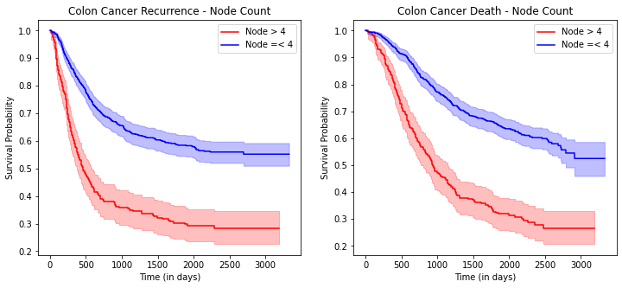
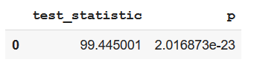
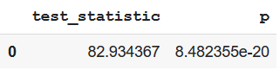
KAPLAN-MEIER
This Log-rank test compare the Nodes 4 or less and nodes greater than 4
We infer the following from the Chi-Square statistics
Survival Probability of Peoples with 4 or lesser nodes are high than that of people with nodes greater than 4.
Log-rank test

Slide 16
COX REGRESSION
COX- REGRESSION

Slide 17
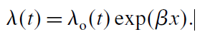
INTRODUCTION TO COX P.H.
KM examined the association of a single independent variable (different treatment or gender) on survival. However, it is often of interest to assess the association between several risk factors, considered simultaneously, and survival time.
An example of the associated data collected for each patient.
Time | rx | sex | age | differ | extent | surg | node4
968 | Lev+5FU | 1 | 43 | 2 | 3 | 0 | 1
542 | Obs | 0 | 71 | 2 | 2 | 0 | 1
245 | Lev+5FU | 0 | 66 | 2 | 3 | 1 | 1
Cox proportional hazards regression is used to relate several risk factors or exposures, considered simultaneously, to survival time. In a Cox proportional hazards regression model, the measure of effect is the hazard rate, which is the risk of failure (i.e., the risk or probability of suffering the event of interest), given that the participant has survived up to a specific time.)
There are several important assumptions for appropriate use of the Cox proportional hazards regression model, including
independence of survival times between distinct individuals in the sample,
A constant hazard ratio over time.
Baseline hazard

Slide 18
Cox PH regression with Single Exploratory Variable: Treatment
Treatment | N | Uncensored
Lev | 294 | 161
Lev+5FU | 289 | 113
Obs. | 305 | 172
A total of 888 patients were followed of which 604 received Lev,620 received Lev+5FU and 620 were under observation.
Treatment | X1 | X2
Obs. | 1 | 0
Lev+5FU | 0 | 1
Mathematical formulation for cox exploratory variables.
Treatment | Coeff | exp(coeff) | p-value | Confidefence interval
Obs | 0.04 | 1.04 | 0.72 | [0.84 -1.29 ]
Lev+5FU | -0.48 | 0.62 | <0.005 | [0.49 -0.78 ]
For Lev+5Fu treatment HR<1,Such a HR implies a better risk for patients receiving the new therapy since HR<1.
95% CI for obs. contains the null hypothesis value, HR=1 (or equivalently =0), of no treatment difference.
HR < 1
Confidence interval does not contain 1
Significant

Slide 19
Cox PH regression for number of lymphatic nodes effected: Node 4
Node4 | N | Uncensored
<4 | 660 | 322
>4 | 230 | 236
A total of 888 patients were followed of which for 230 patients cancer had spread to more than 4 lymphatic nodes.
Treatment | X1
>4 | 1
Mathematical formulation for cox exploratory variables.
Treatment | Coeff | exp(coeff) | p-value | Confidence interval
Nodes >4 | 0.87 | 2.39 | <0.005 | [1.06 -1.97 ]
For group with nodes greater than 4 HR>1,Such a HR implies a more risk for patients with less spread of cancer since HR>1.
95% CI for doesn’t contains the null hypothesis value, HR=1 (or equivalently =0), for difference in number of nodes disease has spread to.
HR > 1
Confidence interval does not contain 1
Significant

Slide 20
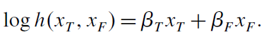
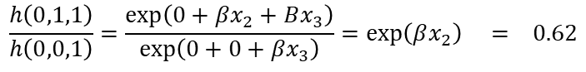
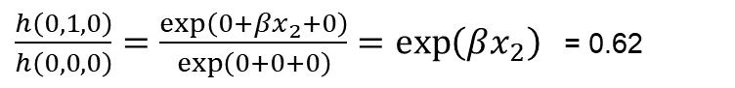
Cox PH regression with TWO Exploratory Variable: Treatment and Node4
Hazard ratio of Lev+5FU with nodes >4
$$\frac{h\left(0,1,1\right)}{h\left(0,0,1\right)}=\frac{\exp\left(0+βx_{2}+Bx_{3}\right)}{\exp\left(0+0+βx_{3}\right)}=\exp\left(βx_{2}\right) = 0.62$$
XT1 | Obs | 1 | 0
XT2 | Lev+5FU | 0 | 1
XN | <4 | 1 | --
$\frac{h\left(0,1,0\right)}{h\left(0,0,0\right)}=\frac{\exp\left(0+βx_{2}+0\right)}{\exp\left(0+0+0\right)}=\exp\left(βx_{2}\right)$ = 0.62
Variable | Coeff | exp(coeff) | p-value | Confidence interval
Obs | 0.04 | 1.04 | 0.73 | [0.84-1.29]
Lev+5FU | -0.48 | 0.62 | <0.005 | [0.49-0.79]
node4 | 0.87 | 2.38 | <0.005 | [1.96-2.89]
Hazard ratio of Lev+5FU with nodes <4
Observation : The adjusted HR for both treatment and nodes do not change compared with crude model. Thus we can say no confounding is present.
This implies that
the treatment effect, which is measured by the size of X , is assumed to be the same, both
for patients who have nodes greater 4 patients and for those who had nodes less than 4.

Slide 21
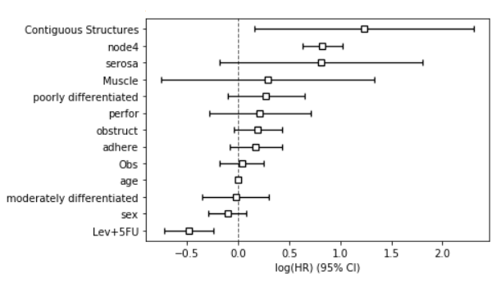
COX PH regression with All Explanatory variables
COX ANALYSIS
sex | -0.11 | 0.9 | 0.26 | [0.74 -1.08]
age | 0 | 1 | 0.55 | [0.99 -1.01]
obstruct | 0.19 | 1.21 | 0.11 | [0.96 -1.53]
perfor | 0.21 | 1.24 | 0.41 | [0.75 -2.04]
adhere | 0.17 | 1.18 | 0.19 | [0.92 -1.53]
node4 | 0.82 | 2.28 | <0.005 | [1.87 -2.78]
Lev+5FU | -0.48 | 0.62 | <0.005 | [0.48 -0.78]
Obs | 0.03 | 1.04 | 0.76 | [0.83 -1.29]
moderately differentiated | -0.03 | 0.97 | 0.87 | [0.71 -1.34]
poorly differentiated | 0.27 | 1.31 | 0.16 | [0.9 -1.91]
Muscle | 0.29 | 1.33 | 0.59 | [0.47 -3.78]
serosa | 0.81 | 2.26 | 0.11 | [0.84 -6.1]
Contiguous Structures | 1.23 | 3.42 | 0.02 | [1.17 -10]
In the plot above variable which do not have CI which contains 1 has been marked.
HR >1 : this implies that patients who have higher depth of penetration of tumour are more at risk. Hazard rate is almost 250% more than lowest tumour penetration group

Slide 22
EFFECTS
MARGINAL EFFECT OF
COVARIATES

Slide 23
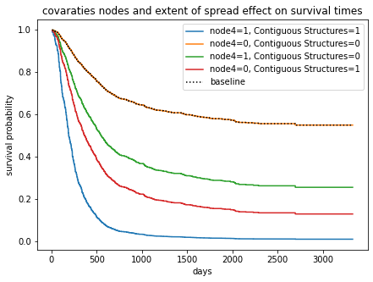
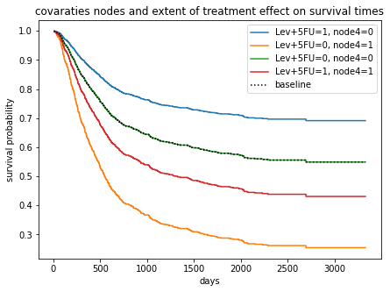
MULTI-VARIATE COX ANALYSIS
01
Effect of number of cancer lymph nodes and spread to contiguous structures
0
Effect of levimasole and fluorouracil and node count on survival probability

Slide 24
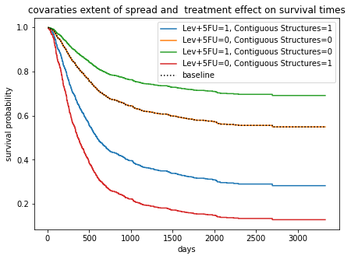
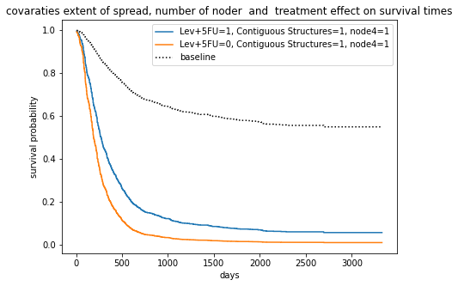
MULTI-VARIATE COX ANALYSIS
Effect of levimasole and fluorouracil and spread to contiguous structures on survival probability
Combined effect of cancer nodes, spread to contiguous structures and treatment.
03
04

Slide 25

CONCLUSION
Impact of the Study
Current Scenario

Slide 26
THANK YOU!

